Slide 1
Automatic Discovery of Tactics in Spatio-Temporal Soccer Match Data
Tom Decroos
Jan Van Haaren
Jesse Davis
KDD’18

Slide 2
Meet Bob, an analyst at Everton FC

Slide 3
Meet Alan, the coach at Everton FC

Slide 4
What Bob’s job looks like now

Slide 5
We are playing Manchester City next week,
I need a summary of their tactics in 3 days!

Slide 6
Bob manually reviews many hours of soccer video footage

Slide 7
Tactics report

Slide 8
Thanks for you hard work.
Can you do it again for our next match?
Tactics report

Slide 9
………
Tactics report

Slide 10
What Bob’s job should look like

Slide 11
Computer, give me the top 5 tactics of Manchester City

Slide 12
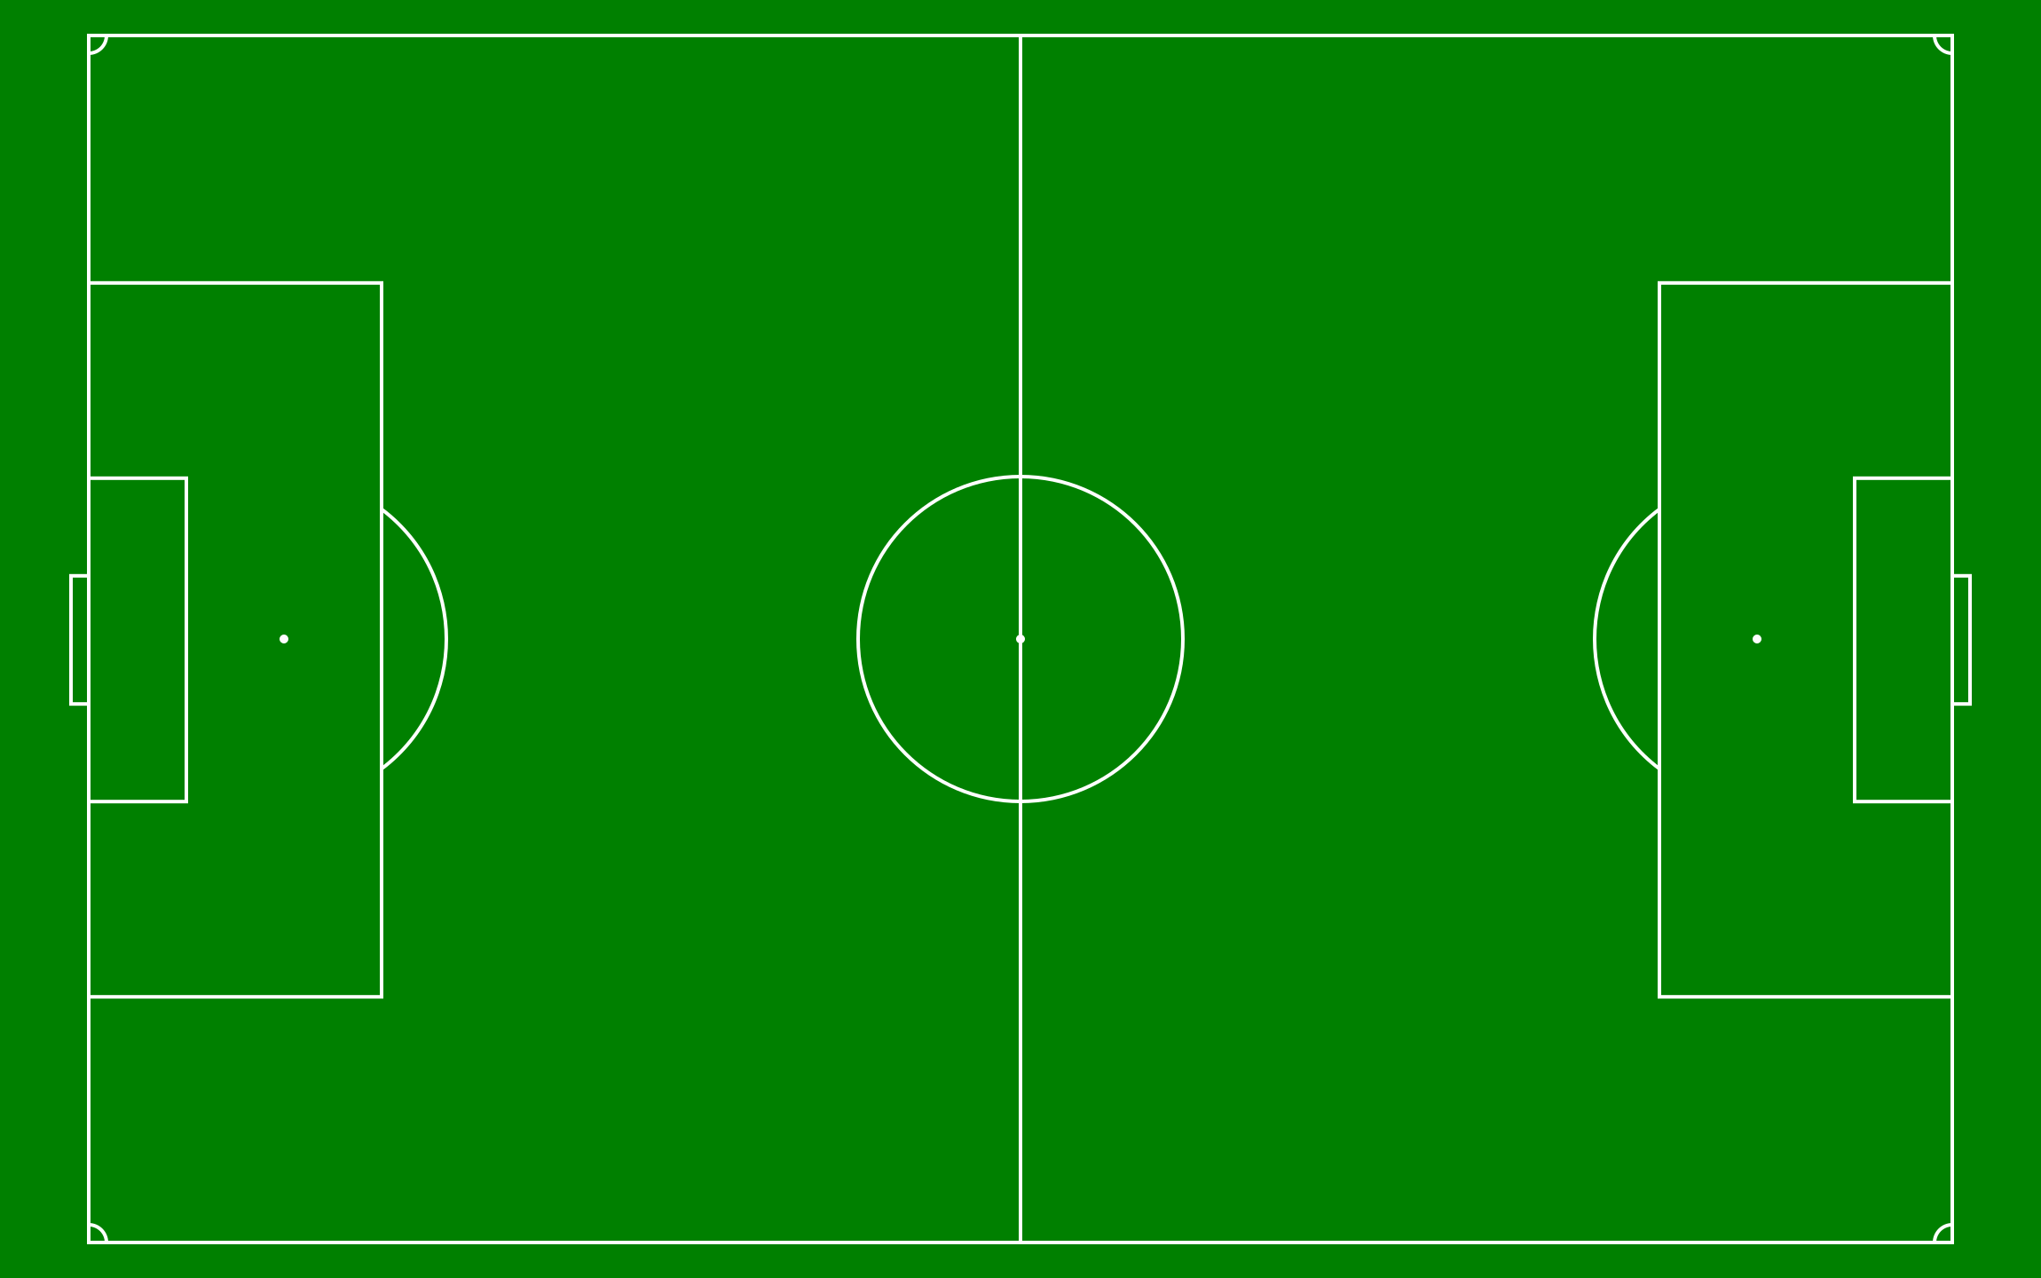

Slide 13
Give me some examples of this tactic

Slide 15
Bob lets the computer automatically discover tactics
Tactics report

Slide 16
Automatic discovery of tactics in spatio-temporal soccer match data
Data
Challenges
Approach
Results

Slide 17
Automatic discovery of tactics in spatio-temporal soccer match data
Data
Challenges
Approach
Results

Slide 18
A soccer match is described by a sequence of +-1750 on-the-ball actions
Tackle
Pass
Pass
Shot

Slide 19
A soccer match is described by a sequence of +-1750 on-the-ball actions
Tackle
Pass
Pass
Shot
Pass
12min 36sec
(32.2, 85.1)
Neil Taylor
Swansea
Time:
Location:
Player:
Team:

Slide 20
Automatic discovery of tactics in spatio-temporal soccer match data
Data
Challenges
Approach
Results

Slide 21
Tactics involve space and time
Frequent itemsets : {Pass, Goal, Pass, Dribble, Tackle}

Slide 22
Tactics involve space and time
Frequent itemsets : {Pass, Goal, Pass, Dribble, Tackle}

Slide 23
Tactics involve space and time
Frequent itemsets : {Pass, Goal, Pass, Dribble, Tackle}
Tackle
Pass
Dribble
Pass
Goal

Slide 24
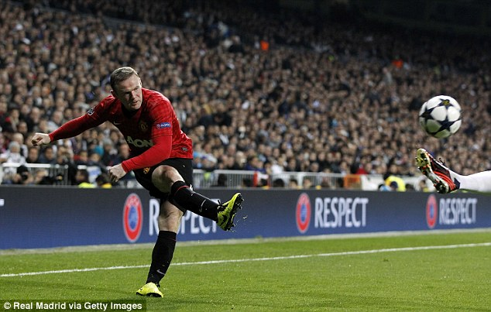
Events have discrete and continuous attributes

Slide 25
Events have discrete and continuous attributes
Type: Pass
Player: Wayne Rooney
Team: Manchester United

Slide 26
Events have discrete and continuous attributes
Type: Pass
Player: Wayne Rooney
Team: Manchester United
X: 83.0
Y: 14.3
Time: 12 min 6.3 seconds

Slide 27
How to exploit domain knowledge?
# Raw data
Player: Hazard
Type: Pass

Slide 28
How to exploit domain knowledge?
# Enriched raw data
Player: Hazard -> Left Winger -> Attacker
Type: Pass -> Corner, Cross

Slide 29
Relevance of tactics is subjective
Attackers care about defence patterns
Defenders care about attack patterns
Coaches care about successful patterns
Journalists care about unique patterns

Slide 30
Events have no universal definition

Slide 31
Events have no universal definition
Aggressive cross?

Slide 32
Events have no universal definition
Aggressive cross?
OR off-target shot?

Slide 33
Automatic discovery of tactics in spatio-temporal soccer match data
Data
Challenges
Approach
Results

Slide 34
Step 1: Divide the event stream of each match into phases

Slide 35
Step 1: Divide the event stream of each match into phases

Slide 36
Step 1: Divide the event stream of each match into phases
Phase i

Slide 37
Step 1: Divide the event stream of each match into phases
Phase i
Phase i + 1

Slide 38
Step 1: Divide the event stream of each match into phases
Phase i
Phase i + 1
Phase i + 2

Slide 39
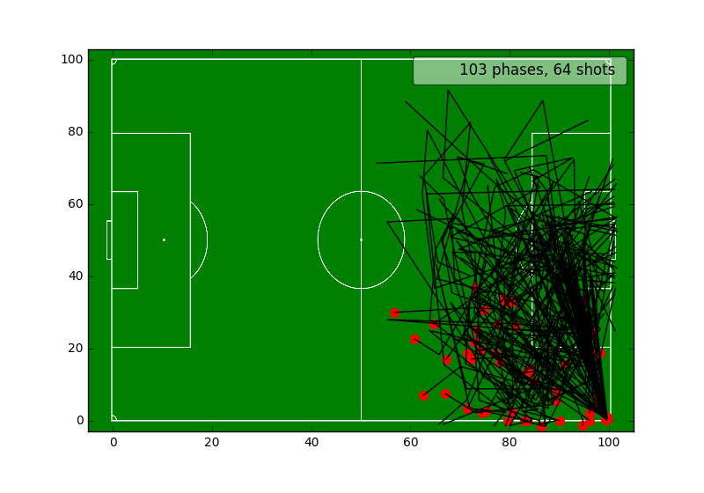
Step 2: Cluster phases on their spatio-temporal component
Distance function =
Dynamic Time Warping
Parameter =
How many clusters?

Slide 40
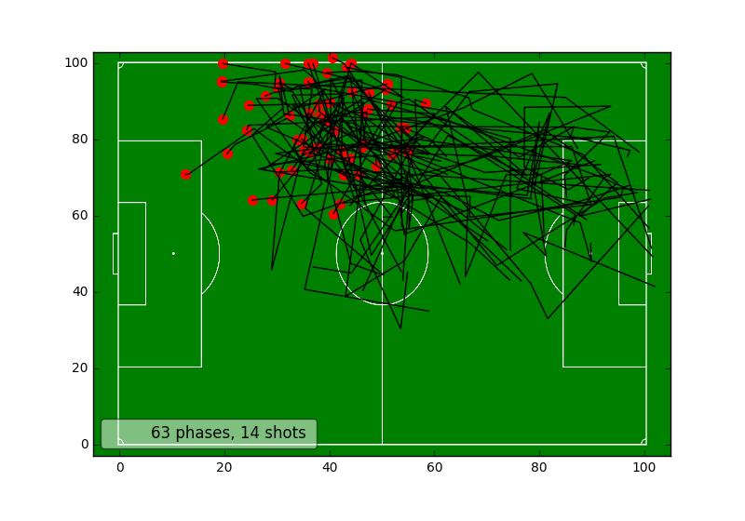
Step 2: Cluster phases on their spatio-temporal component
Distance function =
Dynamic Time Warping
Parameter =
How many clusters?

Slide 41
Step 3: Rank clusters on user preference
Soccer coach
Journalist
Opposing player

Slide 42
Step 3: Rank clusters on user preference
Lots of shots!
Unique phases
Frequent phases
Soccer coach
Journalist
Opposing player

Slide 43
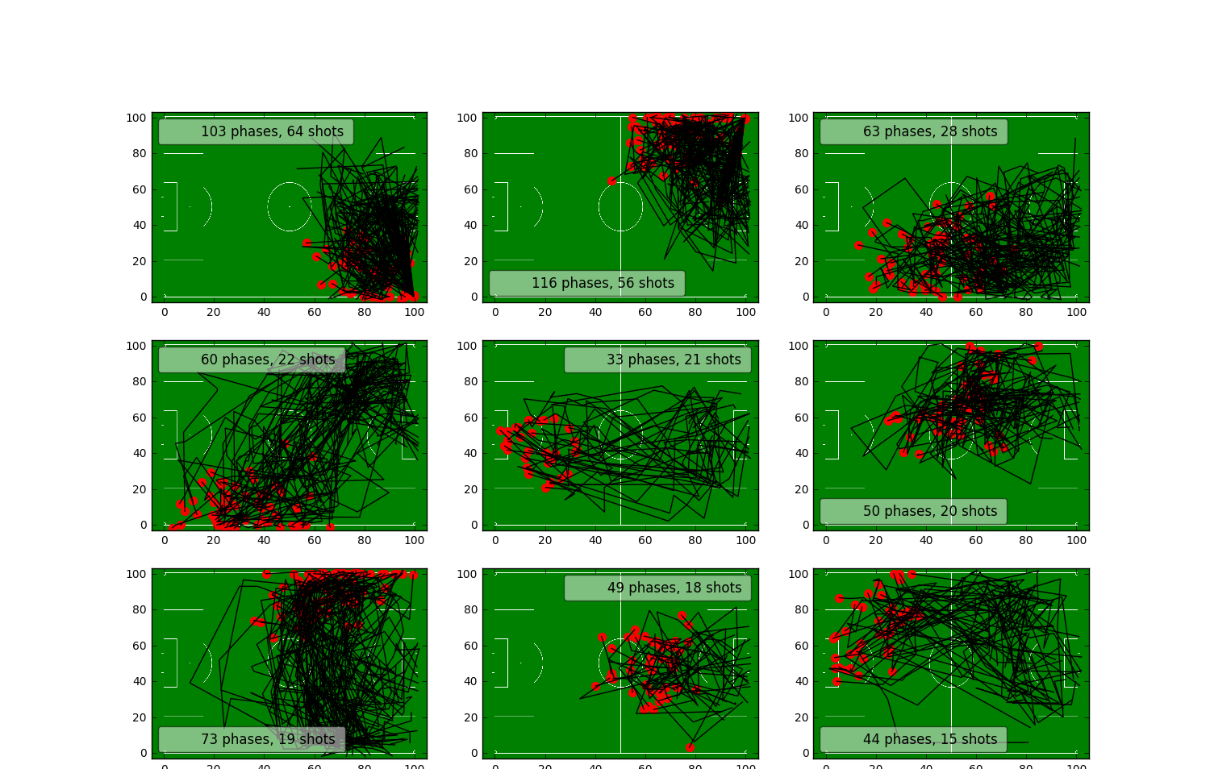
Step 3: Rank clusters on user preference
Lots of shots!
9 clusters with most shots
Soccer coach

Slide 44
Step 4: Mine each cluster for frequent sequential patterns
Sequential pattern mining algorithms (e.g. CM-SPADE)
work on sequences of itemsets

Slide 45
Step 4: Mine each cluster for frequent sequential patterns
Sequential pattern mining algorithms (e.g. CM-SPADE)
work on sequences of itemsets
Q: How to convert a soccer event to an itemset?

Slide 46
Step 4: Mine each cluster for frequent sequential patterns
Sequential pattern mining algorithms (e.g. CM-SPADE)
work on sequences of itemsets
Q: How to convert a soccer event to an itemset?
q1: What information to consider? Player/Event type/Location

Slide 47
Step 4: Mine each cluster for frequent sequential patterns
Sequential pattern mining algorithms (e.g. CM-SPADE)
work on sequences of itemsets
Q: How to convert a soccer event to an itemset?
q1: What information to consider? Player/Event type/Location
q2: How to encode this information? Discretization? Hierarchy?

Slide 48
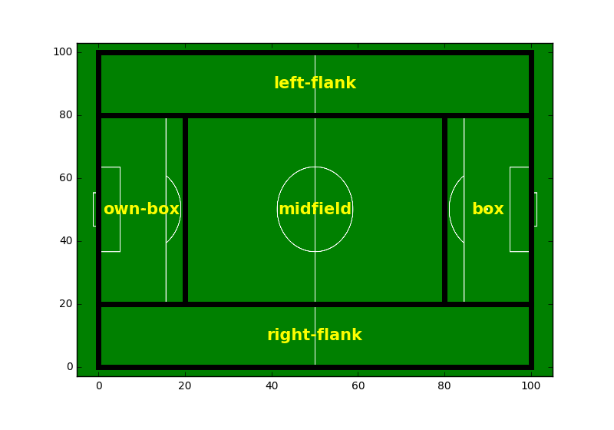
Step 4: Mine each cluster for frequent sequential patterns
Location discretization based on domain knowledge

Slide 49
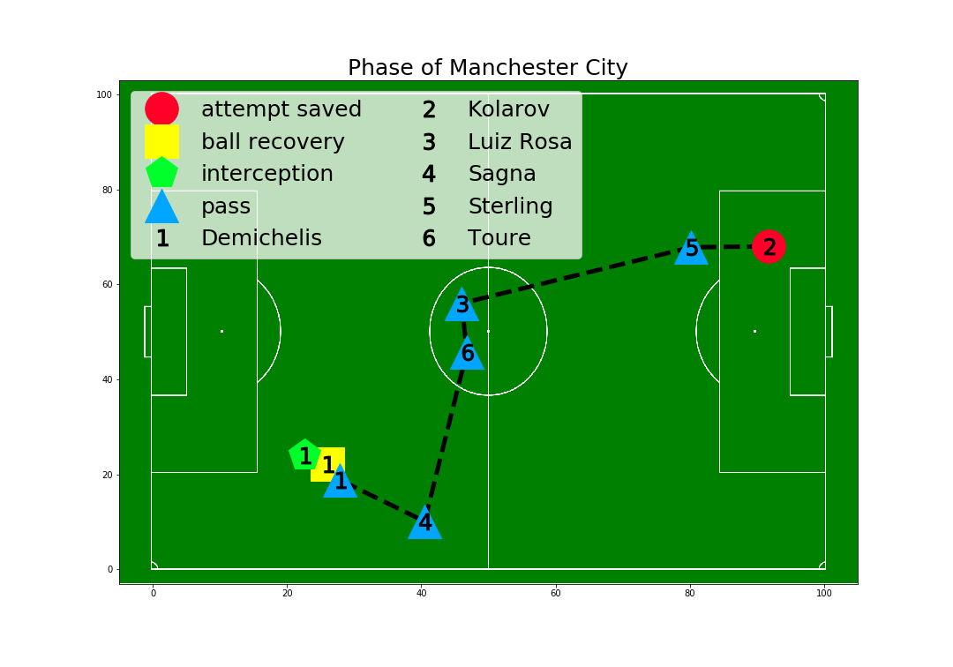
Step 4: Mine each cluster for frequent sequential patterns
Phase
Interception AT the right flank
Ball recovery AT the right flank
A pass FROM the right flank TO the right flank
A pass FROM the right flank TO the midfield
A pass FROM the midfield TO the midfield
A pass OR long ball FROM the midfield TO the box
A pass FROM the box TO the box
Attempt saved AT the box
Shot AT box

Slide 50
Step 4: Mine each cluster for frequent sequential patterns
Pattern
Ball recovery AT the right flank
A pass FROM the right flank TO the midfield
A long ball FROM the midfield TO the box
Shot AT the box

Slide 51
Step 5: Rank patterns on user preference
Shots!
Unique patterns
Frequent patterns
Soccer coach
Journalist
Opposing player

Slide 52
Step 5: Rank patterns on user preference
Shots!
Soccer coach

Slide 53
Step 5: Rank patterns on user preference
Shots!
Soccer coach
W_{ball_recovery} = 1
W_{pass} = 0.5
W_{shot} = 2

Slide 54
Step 5: Rank patterns on user preference
Shots!
Ball recovery AT the right flank
A pass FROM the right flank TO the midfield
A long ball FROM the midfield TO the box
Shot AT the box
Soccer coach
W_{ball_recovery} = 1
W_{pass} = 0.5
W_{shot} = 2

Slide 55
Step 5: Rank patterns on user preference
Shots!
Ball recovery AT the right flank
A pass FROM the right flank TO the midfield
A long ball FROM the midfield TO the box
Shot AT the box
Soccer coach
W_{ball_recovery} = 1
W_{pass} = 0.5
W_{shot} = 2
$$Score\left(p\right)= Support\left(p\right)∗(1+0.5+0.5+2)$$

Slide 56
Automatic discovery of tactics in spatio-temporal soccer match data
Data
Challenges
Approach
Results

Slide 57
Q1: Do we discover interesting and relevant patterns?
Top ranked cluster
of Manchester City
in 2015/2016

Slide 58
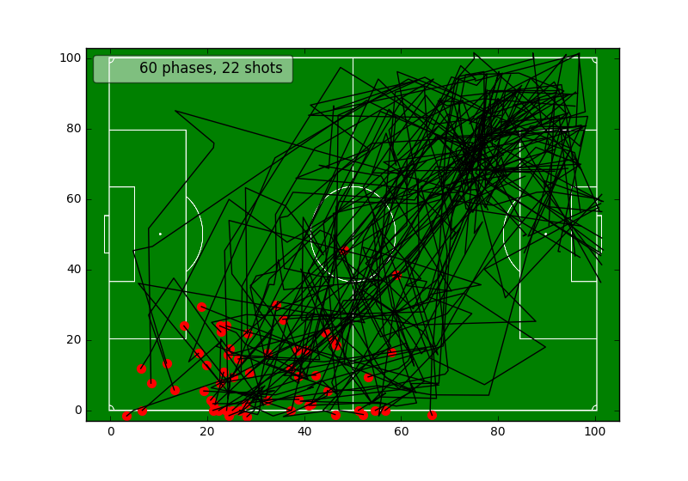
Q1: Do we discover interesting and relevant patterns?
4th ranked cluster
of Manchester City
in 2015/2016

Slide 59
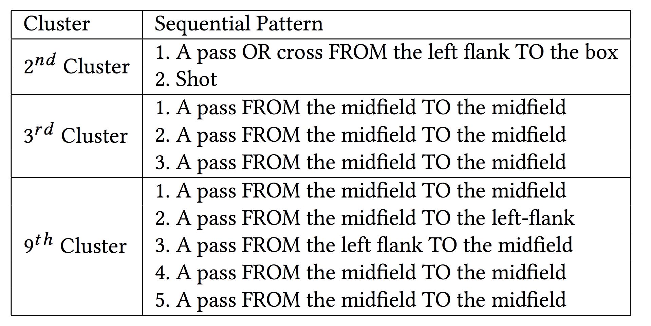
Q2: Can we identify team tactics?
Arsenal = midfield passing

Slide 60
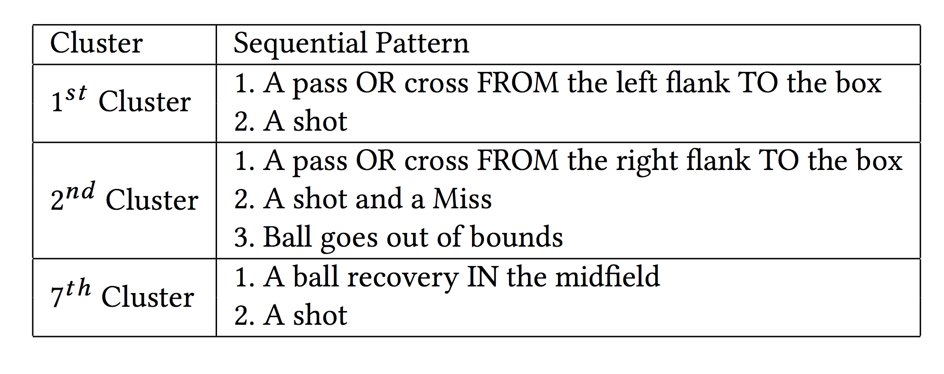
Q2: Can we identify team tactics?
Leicester City = counter-attack

Slide 61
Conclusion
Have we made Bob’s job easier?

Slide 62
Conclusion
Have we made Bob’s job easier?
Not yet, but it’s a good start!

